Slide 1
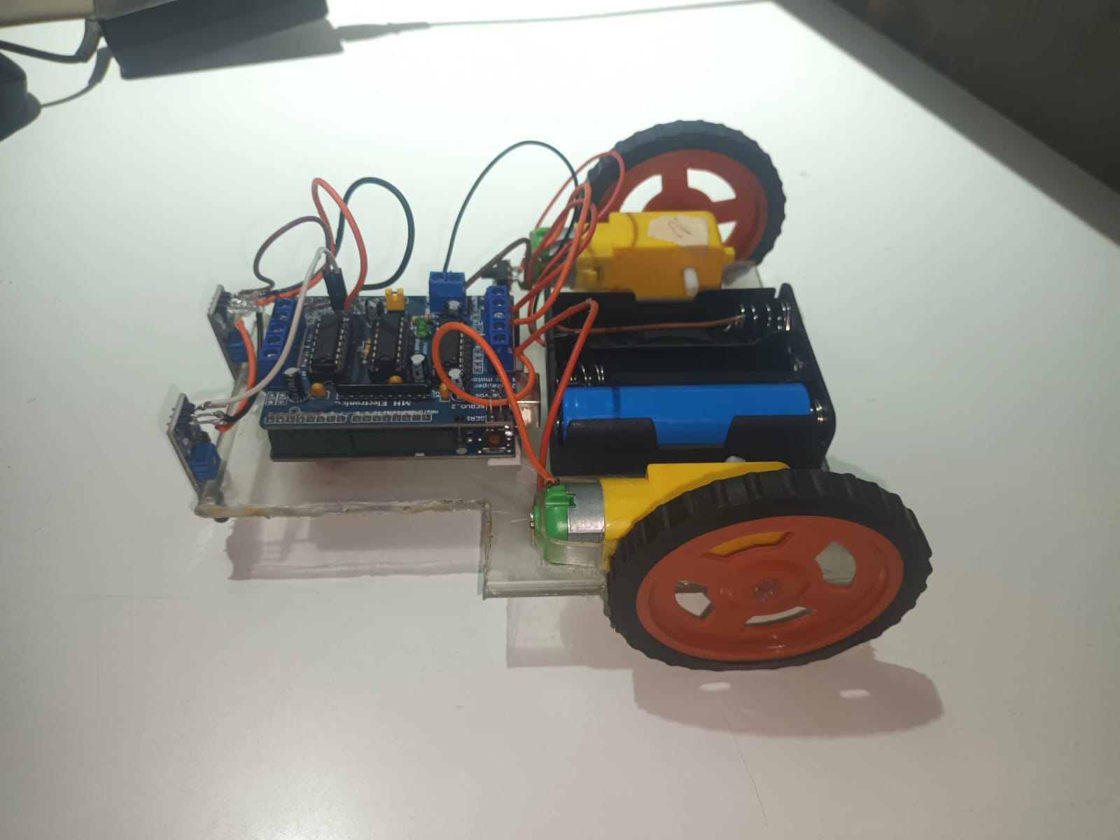
Path Following Car

Slide 2

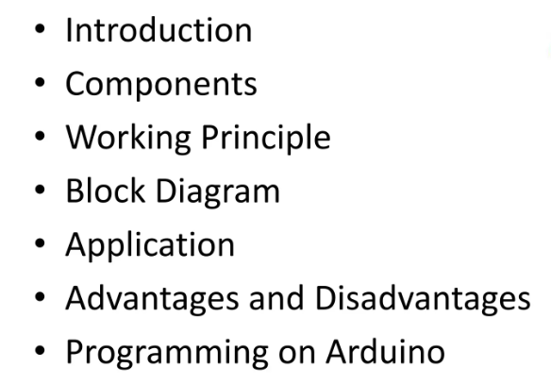

Slide 3
Introduction
Line following Robot is a machine that can follow a path. The path can be visible like a black line on a white surface or it can be invisible like a magnetic field.

Slide 4
Path Following Car
Line following Car is a machine that can follow a path. The path can be visible like a black line on a white surface or it can be invisible like a magnetic field.

Slide 5
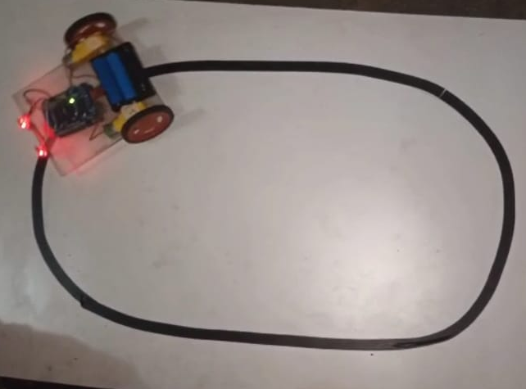
Sensing a line and maneuvering the car to stay on course, while constantly correcting wrong moves using feedback mechanism forms a simple yet effective closed loop system

Slide 6
Components
Arduino Uno R3
IR Sensor
L293D Motor Driver
2 Motors
Wires

Slide 7
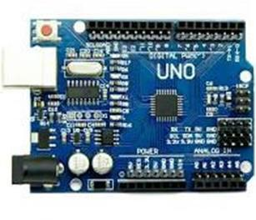
Arduino Uno
Arduino Uno is an open-source microcontroller board that can be programmed to control various electronic devices and systems. In the context of a path following car, Arduino Uno can be used as the main processing unit to control the sensors and actuators of the device.

Slide 8
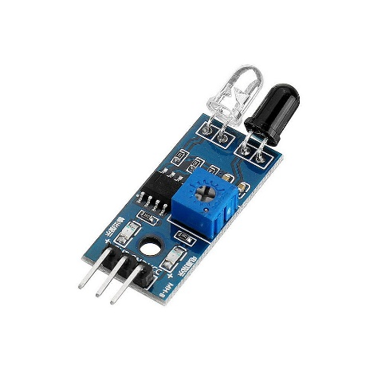
IR Sensor
Infrared (IR) sensors are fundamental components for your path-following car project, serving as the eyes of the vehicle to perceive its environment. These sensors emit infrared light and measure the intensity of the light reflected back from nearby objects.

Slide 9
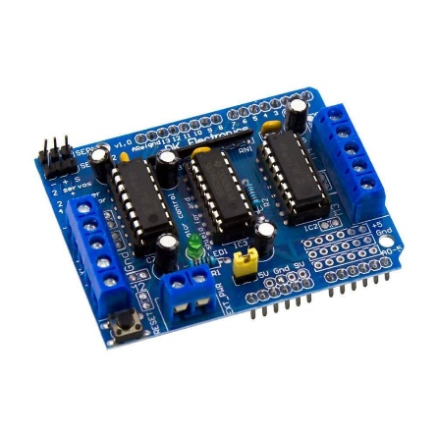
L293D Motor Driver
The L293D motor driver is a popular integrated circuit used to control the speed and direction of DC motors. It provides a convenient solution for interfacing motors with microcontrollers like Arduino. The L293D can drive two DC motors independently or one stepper motor, making it versatile for various robotics and automation projects.

Slide 10
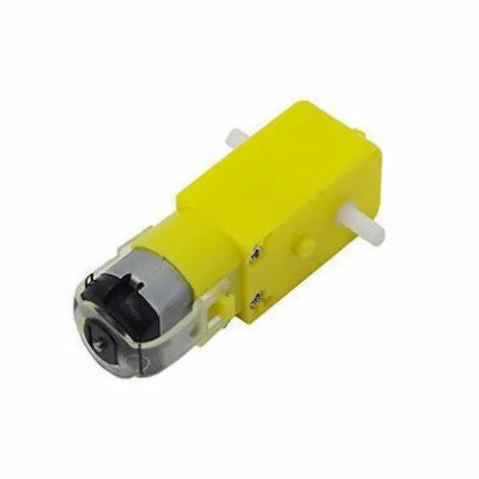
BO Motor
A BO (Brushed DC) motor, short for "Brushed Direct Current" motor, is a type of electric motor commonly used in robotics, automation, and hobbyist projects. It consists of a rotating armature (the rotor) and stationary magnets (the stator).

Slide 11
Working Principle
The IR sensor detects the light emitted by the transmitter, if the receiver receives light, the wheel of that side will keep on moving, as soon as the receiver stops receiving the light (black color absorbs the light and thus no light es reflected so receiver cannot receive any light) the wheel of that side will stop.
For turning, the car stops 1 motor and runs the second to make the turn possible.
For e.g.: If the car has to turn right then the motor on right side will stop and left motor will keep on running and thus allowing the car to turn

Slide 12
Motor Logic
Left IR Sensor | Right IR Sensor | Motion
0 | 0 | Forward
0 | 1 | Right
1 | 0 | Left
1 | 1 | Stop

Slide 13
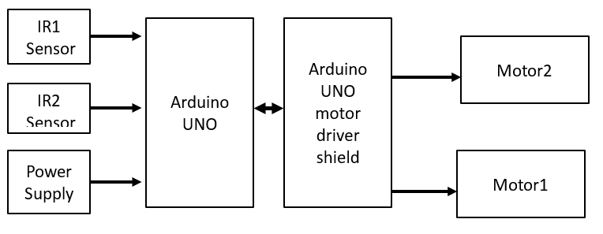
Block Diagram

Slide 14
Applications
The path-following car can be employed in warehouse automation to transport goods along predefined routes, optimizing efficiency and reducing labor costs.
By navigating autonomously between crop rows, the car can assist farmers in tasks such as seeding, spraying, and monitoring, enhancing productivity and precision in agricultural operations.
Equipped with cameras and sensors, the car can patrol designated areas, following predetermined paths, and providing real-time monitoring for security purposes.
The project can serve as an engaging educational tool in STEM (Science, Technology, Engineering, and Mathematics) classrooms, allowing students to learn about robotics, programming, and automation through hands-on experimentation and project-based learning.

Slide 15
Advantages
The path-following car streamlines operations by autonomously navigating along predefined routes, reducing the need for manual intervention and optimizing workflow efficiency.
With its ability to detect obstacles and navigate around them, the car minimizes the risk of collisions and accidents, enhancing workplace safety in industrial settings.
By automating repetitive tasks such as material transport or surveillance patrols, the path-following car reduces labor costs and improves resource utilization, resulting in significant cost savings over time.
The modular design of the path-following car allows for easy customization and scalability to accommodate changing operational needs and environments, ensuring adaptability and versatility in various applications.

Slide 16
Disadvantages
LFR can move on a fixed track or path.
It requires power supply.
Lack of speed control makes the robot unstable at times.
Choice of line is made in the hardware abstraction and cannot be changed by software.

